Slide 1
We ❤️ reuse
Joseph Farthing
Communication Manager

Slide 2
What are two of the most avoidable sources of waste?
(in the University as a whole)

Slide 3
It’s those disposable plastics
Coffee cups – they’re really hard to recycle
Plastic bottles
Plastic bags (before the 5p tax…)
Maybe plastic straws?

Slide 4
Students are thirsty for change
Access to drinking water was the #2 issue in our 2015-16 student survey.
A follow up survey found that 72% of students weren’t drinking enough!
The average student was spending upwards of £80 a year on bottled water…
Lots of complaints about the KeepCup only discount…

Slide 5
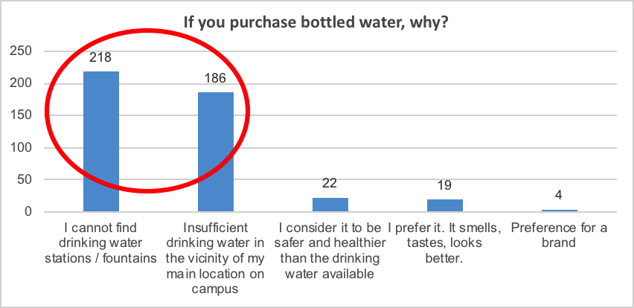

Slide 6
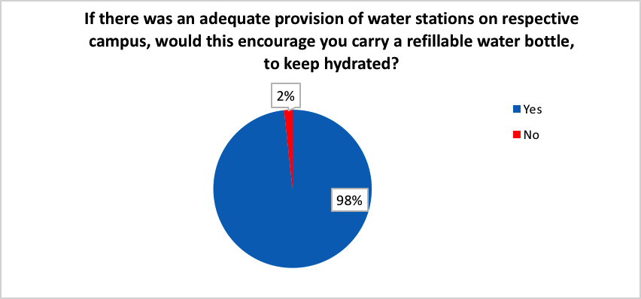

Slide 7
Two paths to making a change
Drinking water project
Installing or upgrading about 200 water points.
Trialling the sale of new Dopper water bottles (at cost price).
Making a map to show where the water points are.
Update our policy.
Coffee cup project
Introducing a ’disposable cup surcharge’ – 25p to take a cup.
Accepting all reusable cups in all University cafés.
Distributing several thousand free cups to students in the new term.

Slide 9
Future steps…
Where things could go from here
Partnership with local universities and businesses?
  Edinburgh College and Napier are on board, looking at adding cafés.
Recycling coffee cups work being done (but reuse is our preference).
Possible collaboration with local schools.
Deposit return system? (We’re members of Have You Got The Bottle)

Slide 10
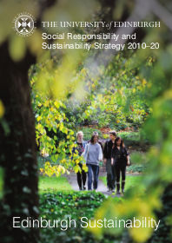

Questions?
Joseph.Farthing@ed.ac.uk
www.ed.ac.uk/sustainability

