Slide 1


Waste and Recycling Coordinator Meet Up
Wednesday 14th June 2017

Slide 2
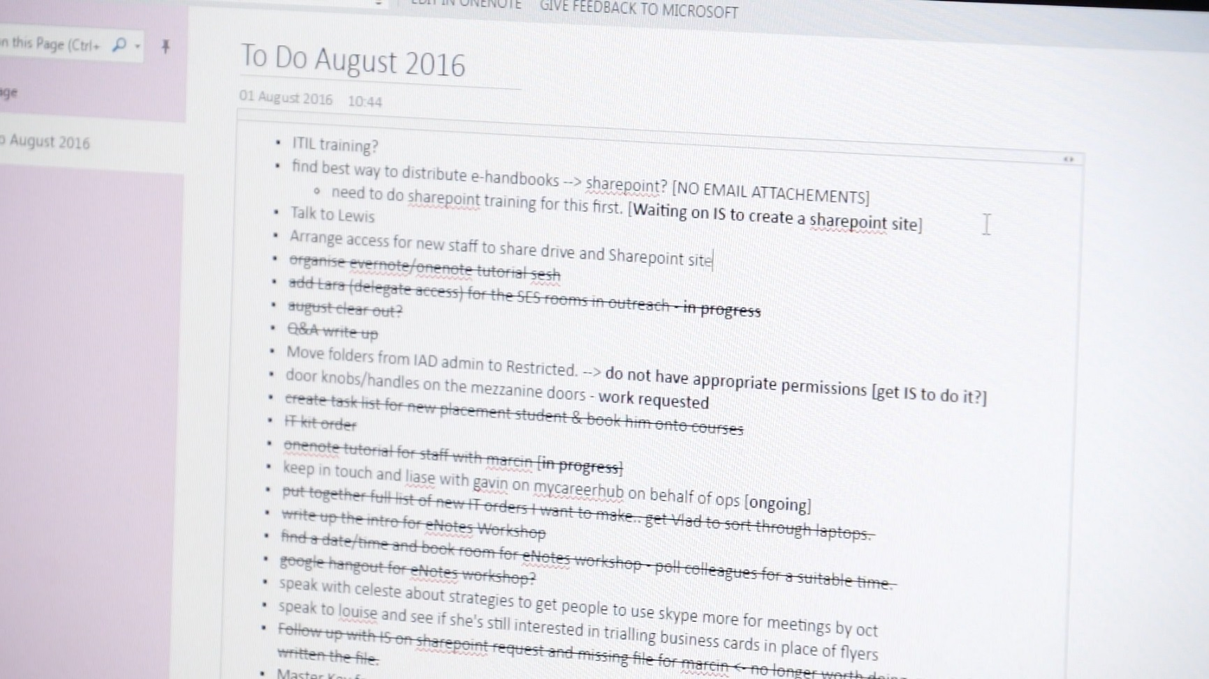
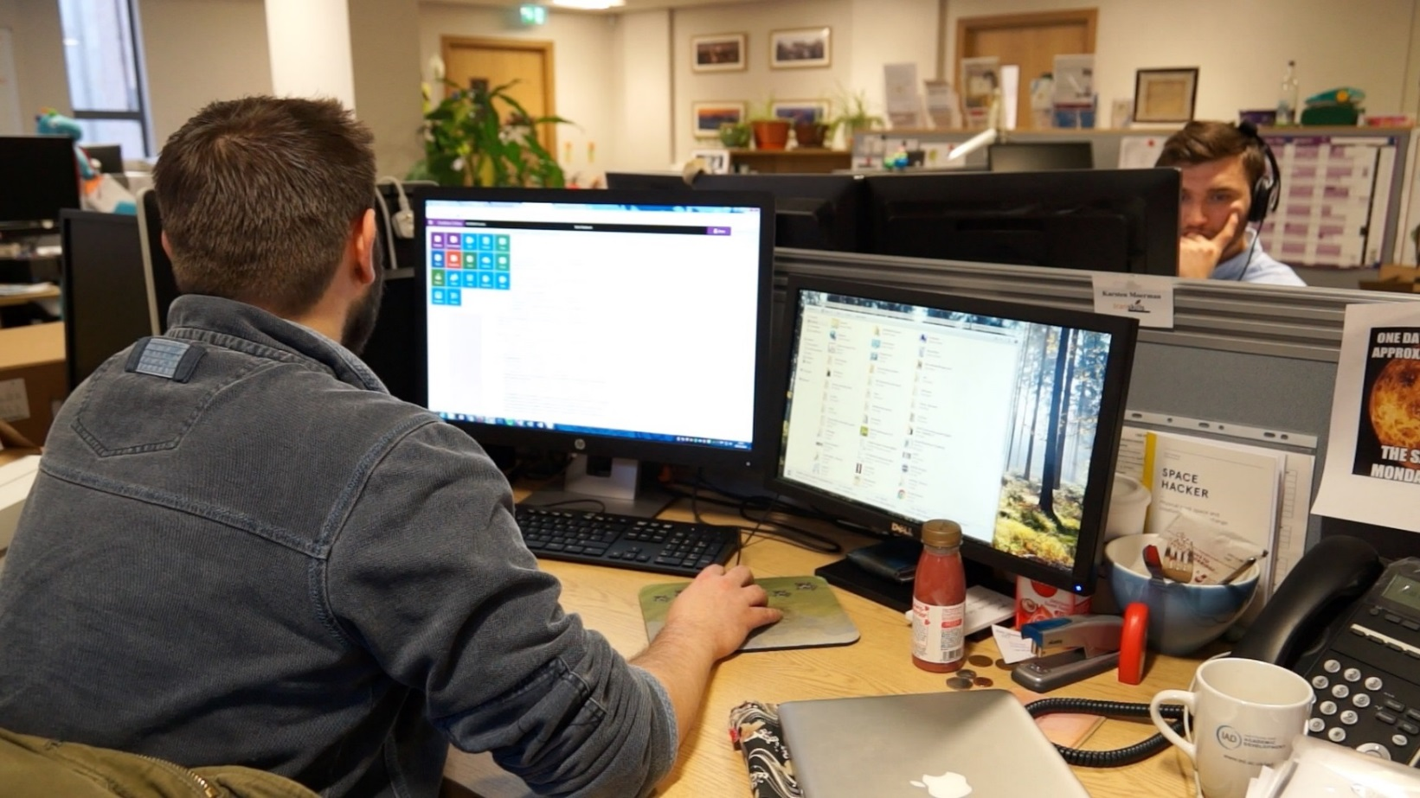
Technology

Slide 3
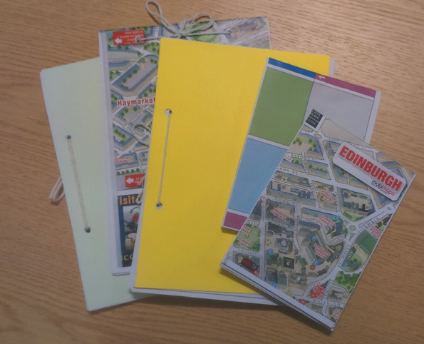
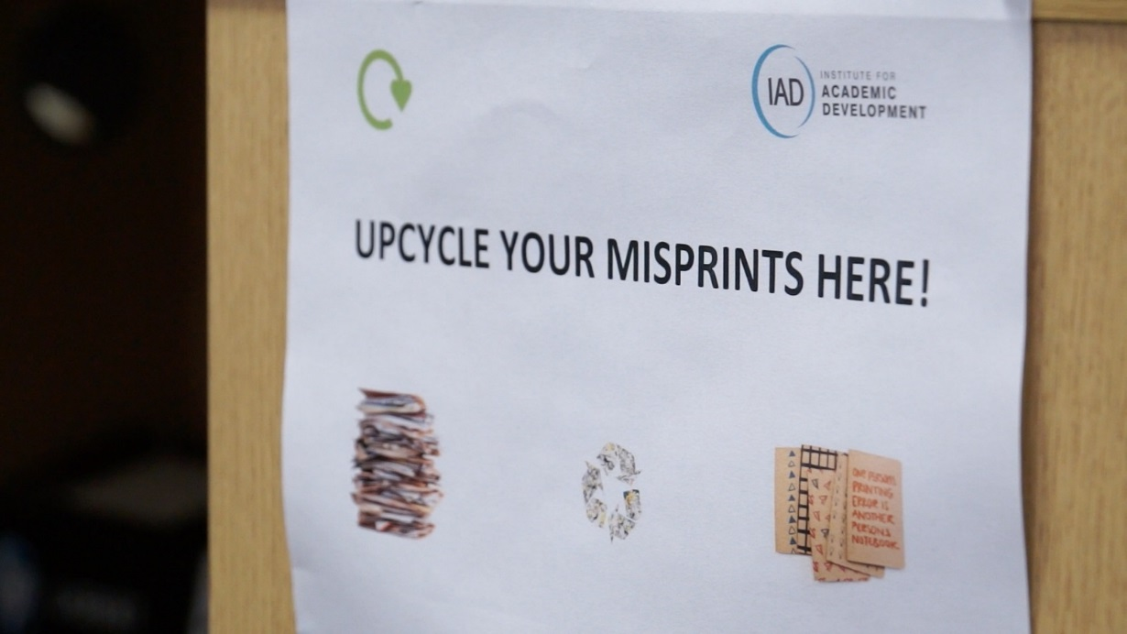
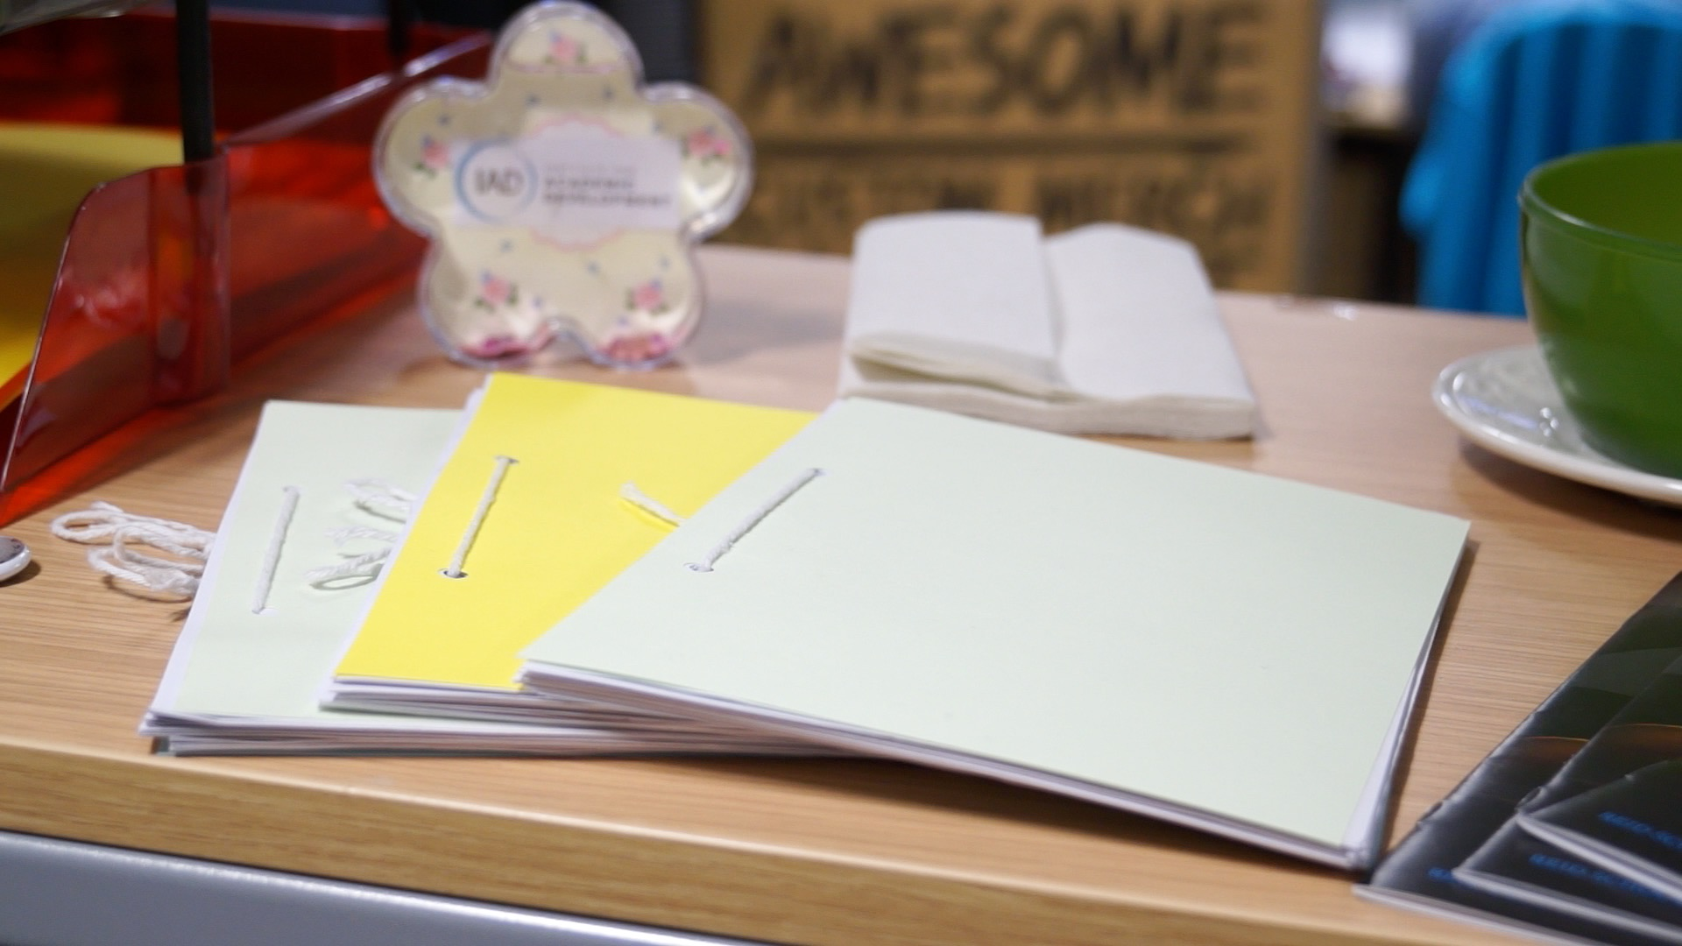
Creativity

Slide 4
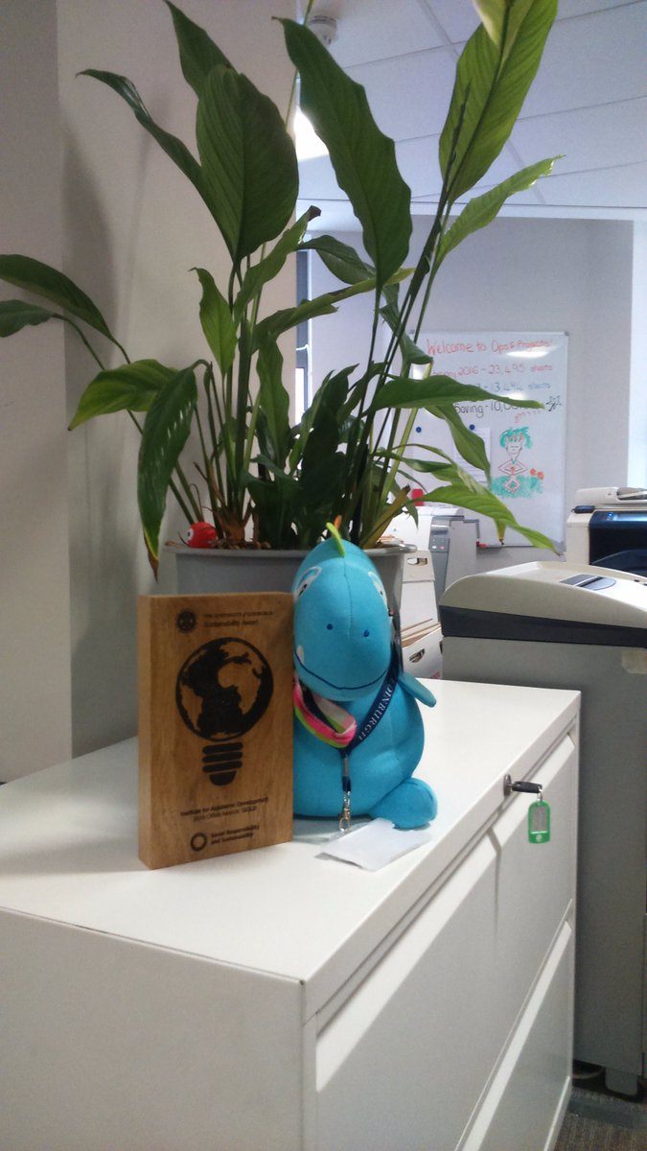
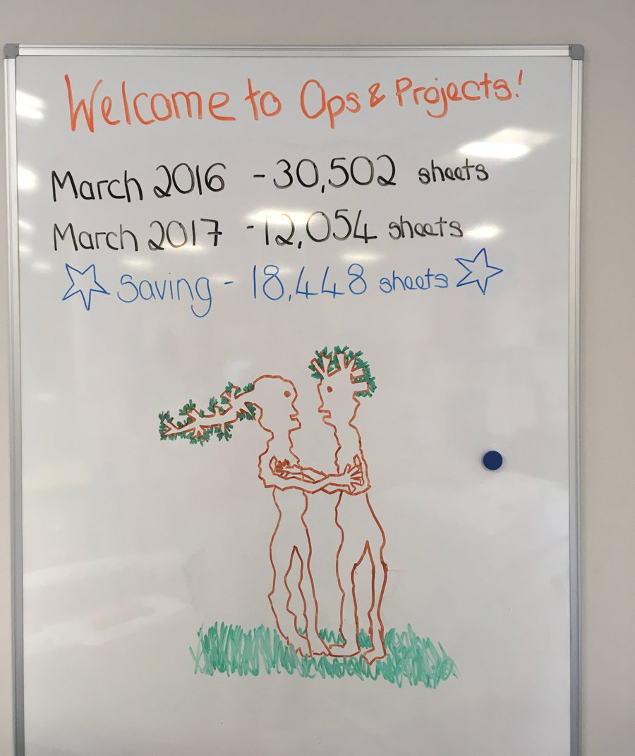
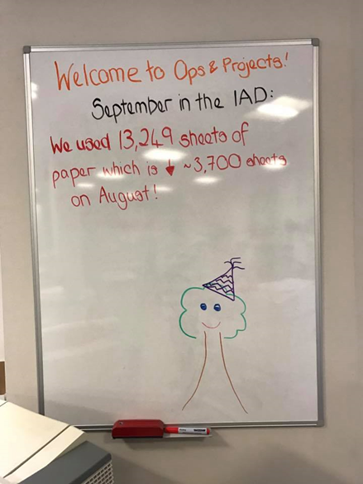
Awareness

Slide 5
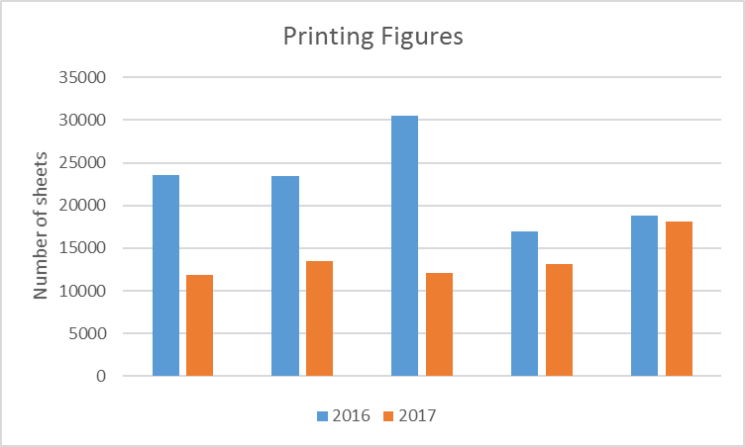
Reporting
2017 Savings by Month
January – 11,728 sheets
February – 10,001 sheets
March – 18,448 sheets
April – 3,815 sheets
May – 678 sheets

