Slide 1



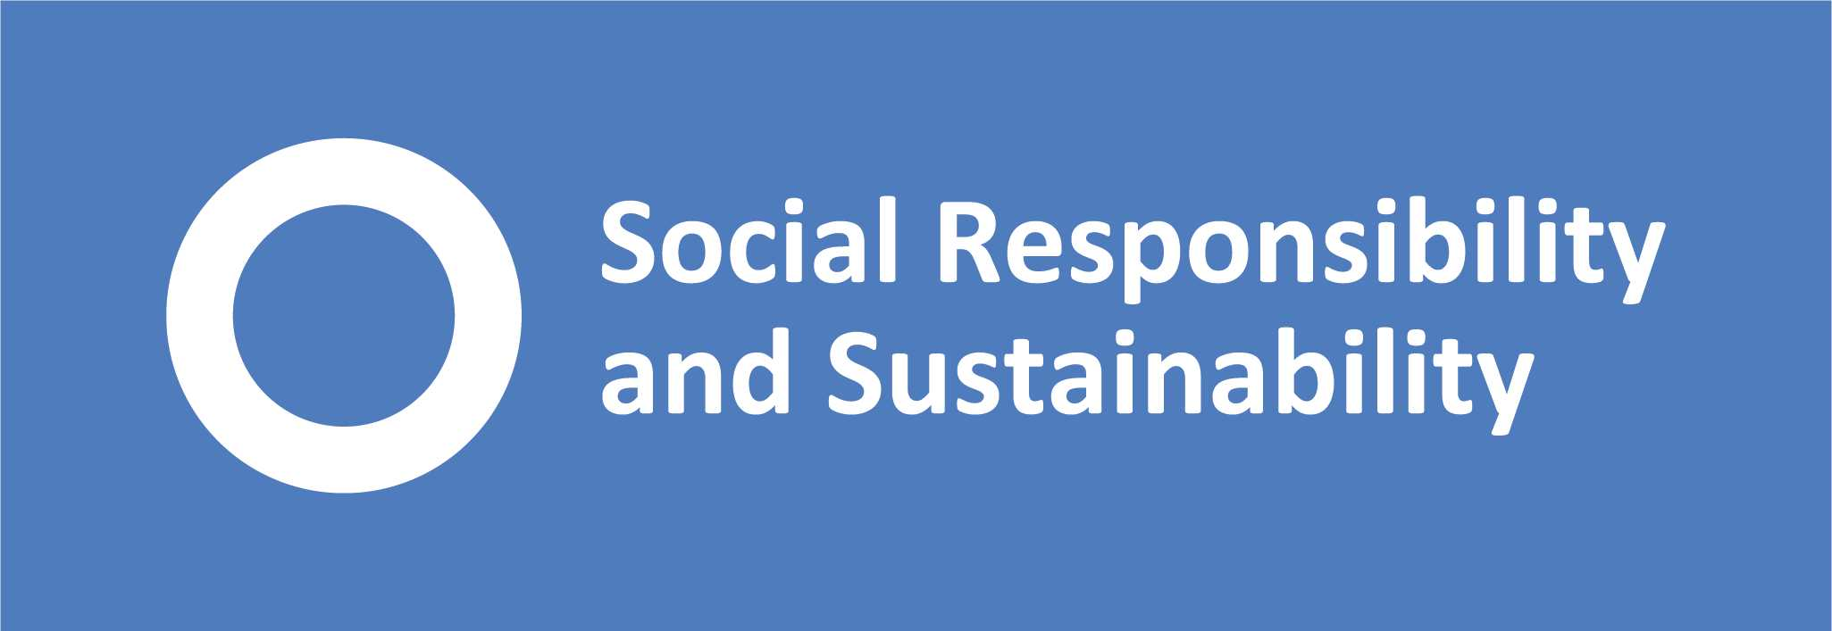
Fairphone
Calling for a better world
By Alyssa, Heather, Lightman, Matt and Patrick
Notes:
Might have to have assignment title in here

Slide 2
OBJECTIVES
'BENCHMARKING FAIRPHONE AGAINST OTHER BRANDS HOW TO INCREASE FAIRPHONE AMONG UNIVERSITY STAFF AS CHOICE OF COMPANY PHONE'
Aims:
The aim of this project was to compare the Fairphone’s ethical standards against competitor phones.
Survey whether Fairphone would be the choice of staff handset, given its sustainability credentials.
Key Objectives:
Review the social and environmental impact of Fairphone against other leading smart phone providers.
Survey university staff in order to collect data about mobile phone choice and use.
Make recommendations to the University about sustainable options for company provided mobile phones.
Notes:
Outline SRS specs and what we have researched & done in the presentation

Slide 3
Outline
Background
The Phone Industry
The Survey
Analysis of Findings
Recommendations
Conclusions
Environmental Impact of Production
Discussion
Limitations Of The Survey
How to Encourage Fairphone Usage
Future Research
Last Thoughts
Results
The Parameters
Questions
Notes:
Background - The phone industry & the environment
Competition & comparison
Survey & discussion
Limitations what the survey found
recommendations
Future research & con

Slide 4
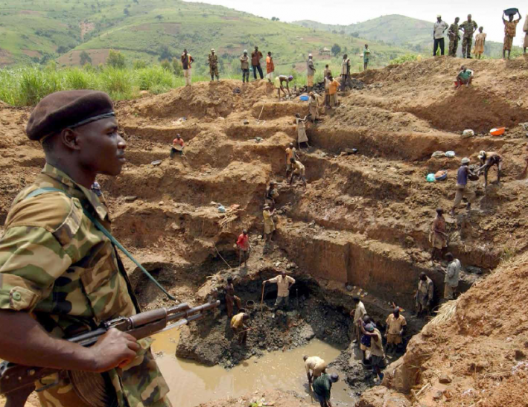
The Phone Industry and the Environment
Biodiversity loss and deforestation
Air and water pollution
Soil erosion
(Butsic et al., 2015; Sovacool, 2019)
Notes:
(All this information found in Sovacool (2019))
In a special report on ASM, the World Bank (2007: 10) suggested that the environmental impacts from ASM mining cut across:
• Biodiversity loss and the destruction of natural habitats through mines and disposal sites;
• Air pollution through emissions and discharges;
• Siltation of wetlands and riparian areas from processing slimes;
• Changes in river ecology due to pollution, sedimentation, and flow modification;
• Deforestation;
• Soil erosion;
• Land instability and ground subsidence

Slide 5
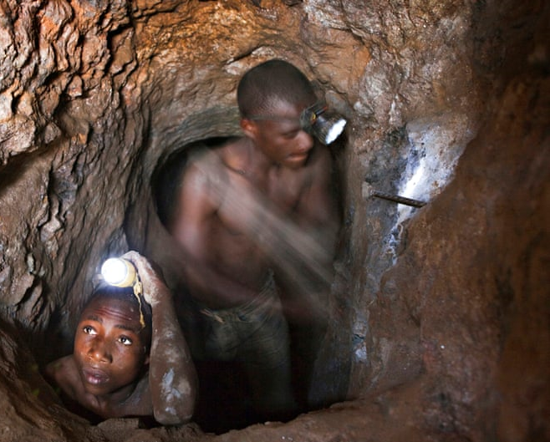
UNICEF estimates there are around 40,000 child miners in the DRC, many as young as 7
For more info watch the documentary blood in the mobile

Slide 6
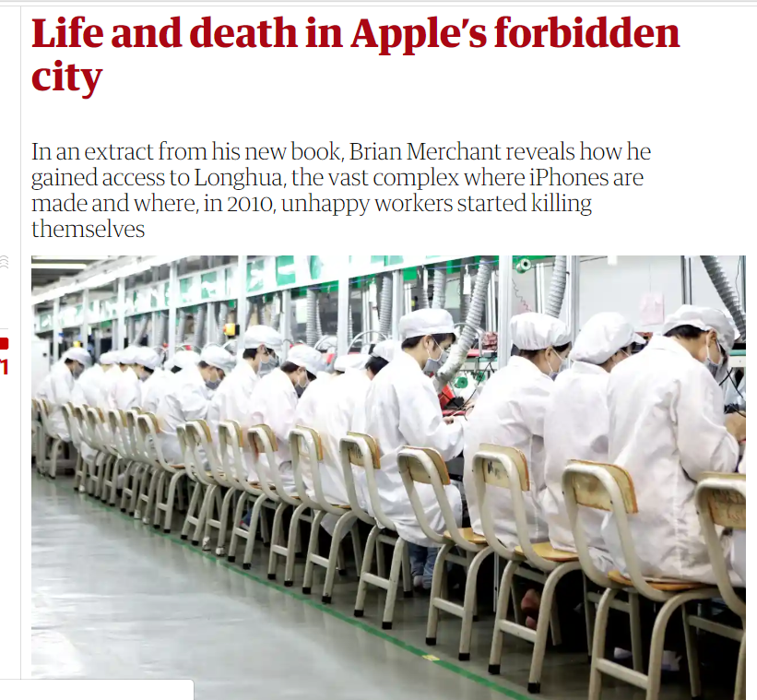
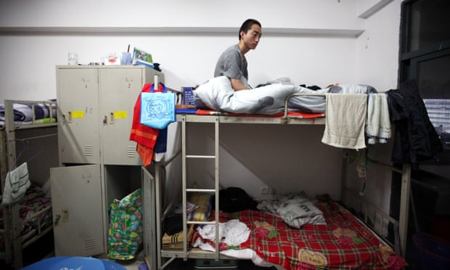

Slide 7
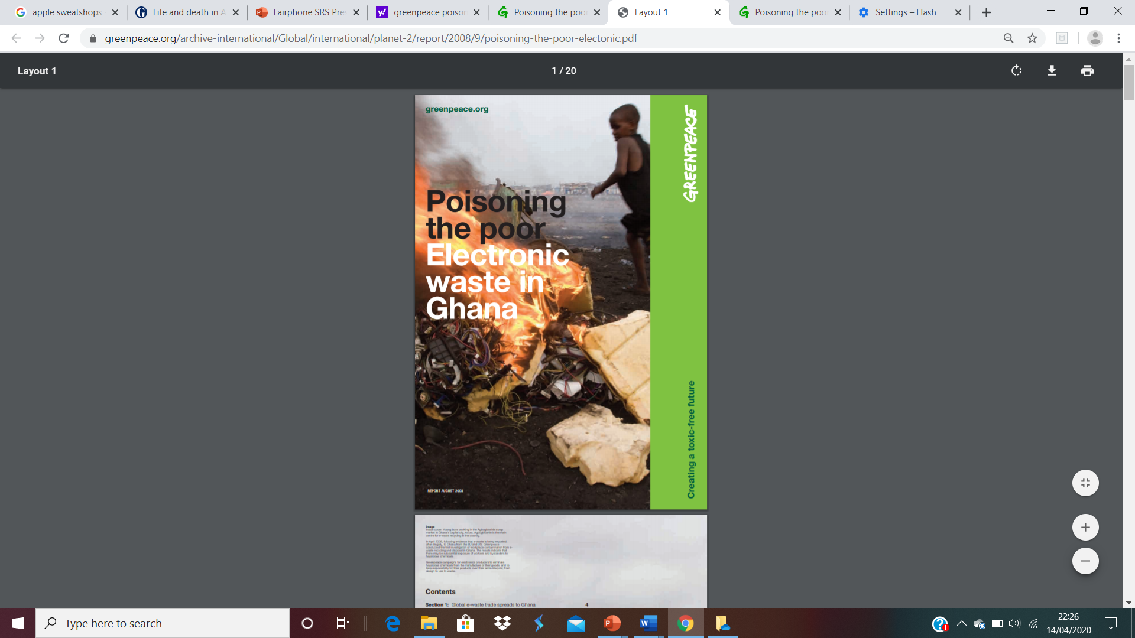
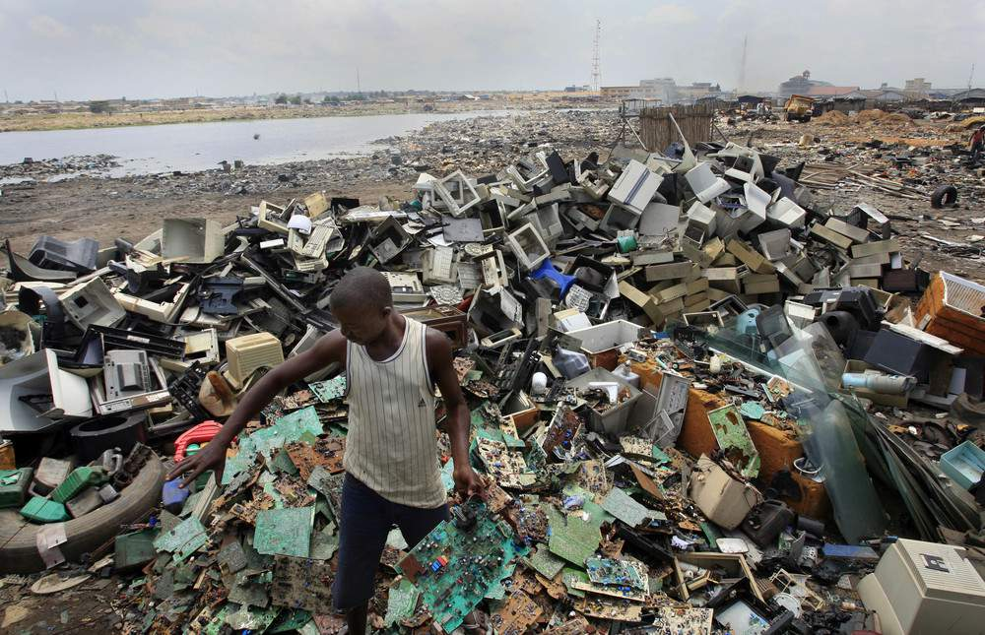
Notes:
Waste and recycling
Currently phone waste from the UK often ends up in Ghana, West Africa as we don't have the means to recycle here. Neither do they. Forms toxic waste dumps as they dispose by burning. Huge health issue

Slide 8
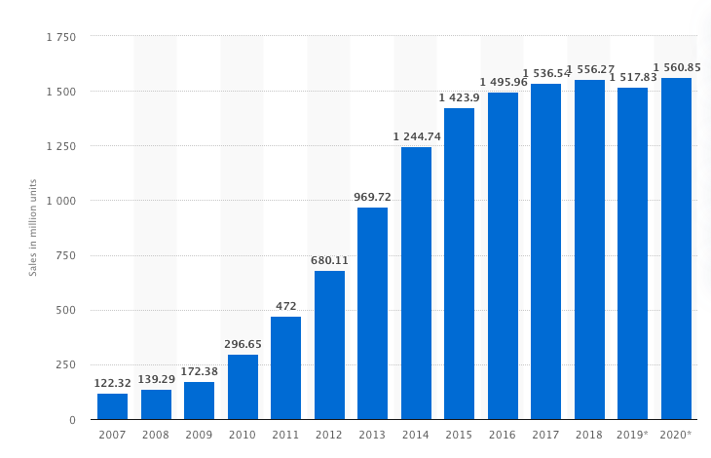
The phone industry
Number of Smartphones sold worldwide from 2007 to 2020 (in million units)
(Statista, 2020)
Notes:
First of all, I am going to talk about the phone industry.
Here is a graph shows the number of smartphones sold to end users worldwide.
We can see from it that 2007 – 2018, annual global smartphone sales is continuously increasing.
Be specific, In 2016, the number of smartphones sold to consumers stood at around 1.5 billion units, a significant increase from the 680 million units sold in 2012. This means that over 28 percent of the world’s total population owned a smart device in 2016, a figure that is expected to increase to 37 percent by 2020.
(2007 – 2018, annual global smartphone sales rose from 122.3 million to 1.55 billion. (Statista, 2020) (I took this out since it is now illustrated in the slide, Heather)

Slide 9
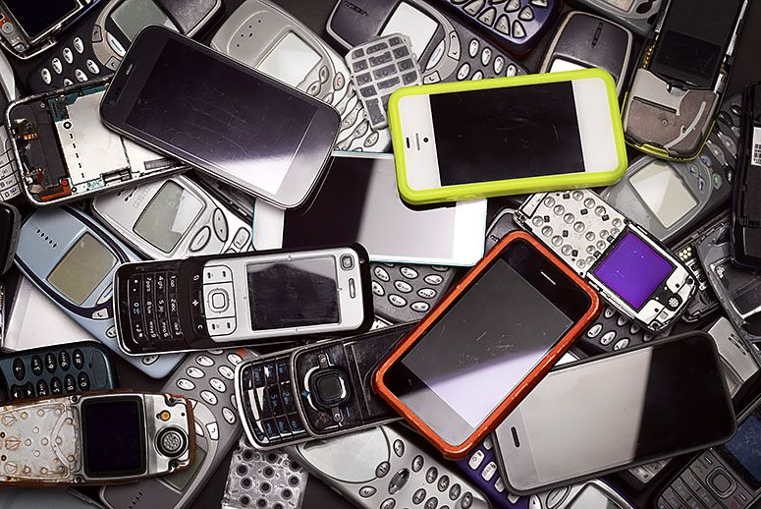
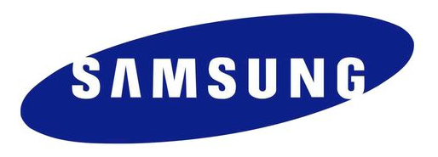
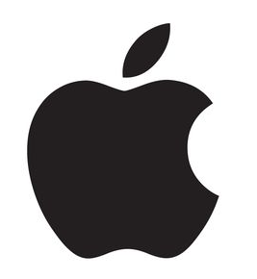
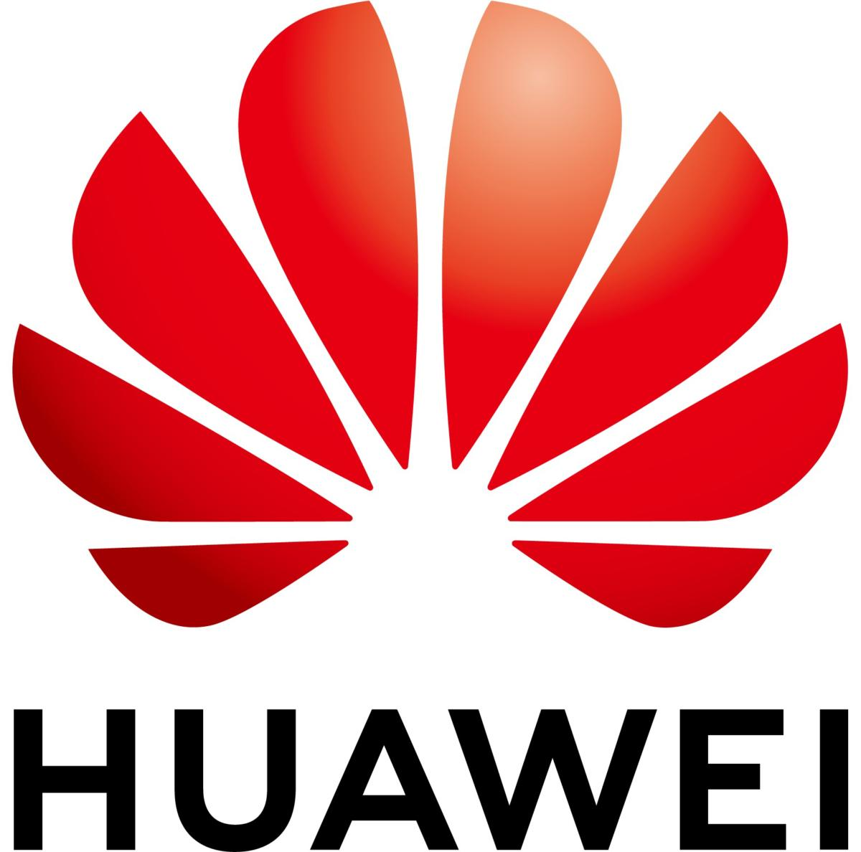
The phone industry
The leading manufacturers in 2019 were
Samsung (295.7 million)
Huawei (240.6 million)
Apple (191 million)
(Statista, 2020)
Notes:
Among them, the biggest vendors were Samsung (295.7 million), Huawei (240.6 million), and Apple (191 million) in 2019. (Statista, 2020)

Slide 10
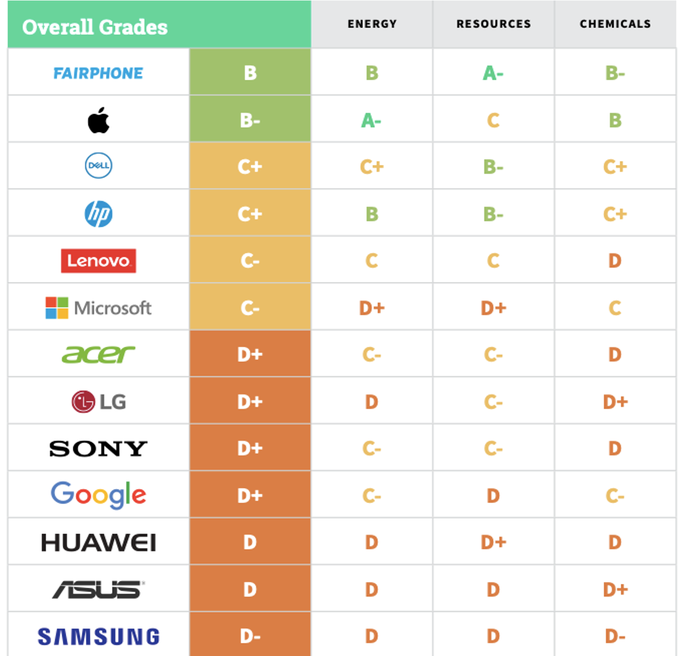
The phone industry
Transparency | Commitment | Performance | Advocacy
Renewable Energy & Climate Change
Sustainable Design and Resource Reduction
Hazardous Chemical Elimination: Products and Supply Chain
Source: Greenpeace (2020)
Notes:
In 2017, Greenpeace uses publicly available information from each smartphone company to evaluate the Transparency, Commitment, Performance, and Advocacy from 3 dimensions: Renewable Energy & Climate Change, Sustainable Design, Resource Reduction & Hazardous Chemical Elimination: Products and Supply Chain.
After a comprehensive comparison and analysis, Fairphone got B, which is the highest grades. However, the best-selling Apple got B- while Huawei got D and Samsung D-.
So what Fairphone is? Why its grade could surpass the best-selling phone brands？

Slide 11
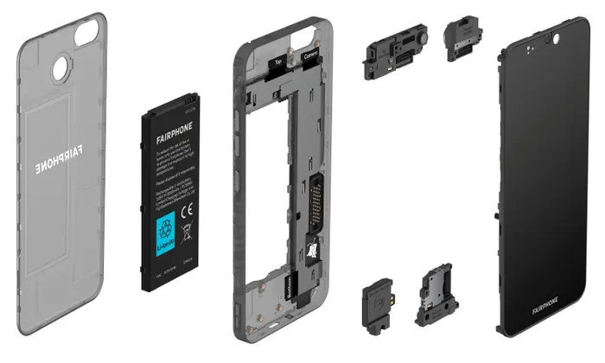
Information about FAirphone
‘Putting ethical values first … changing the way products are made’
Making ‘positive impacts across the value chain in mining, design, manufacturing and life cycle’
Fairphone ‘care about human rights and worker well-being’
‘Design longer-lasting products that are easier to repair’
‘World’s first modular phone’
Dual sim technology
Utilises ‘Fairtrade certified gold’ and ‘fairer materials and more responsible practices’
Creating a ’fairer and more sustainable electronics industry’
(Fairphone, 2020)
Source: Fairphone (2020)
Notes:
Fairphone is a Dutch mobile phone manufacturer which hopes to achieve fair trade in the global mobile phone supply chain.
Its mobile phone design concept is to make the entire mobile phone supply chain and the production costs behind it transparent.
Specifically, it does not use “conflict minerals” and ensures that workers who produce mobile phones are not enslaved and crushed.
FairPhone is more inclined to provide sustainable mobile phones. If your phone is forced to be replaced due to obsolescence, it is not considered to be truly sustainable.
The modular design has been used since Fairphone2. It makes the disassembly of the entire mobile phone completely effortless, and it is very friendly for the user's subsequent self-maintenance and long-term use.

Slide 12
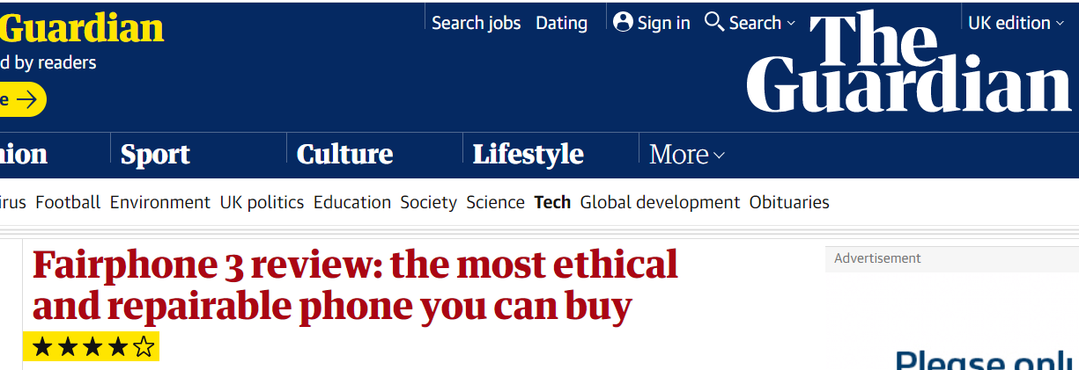
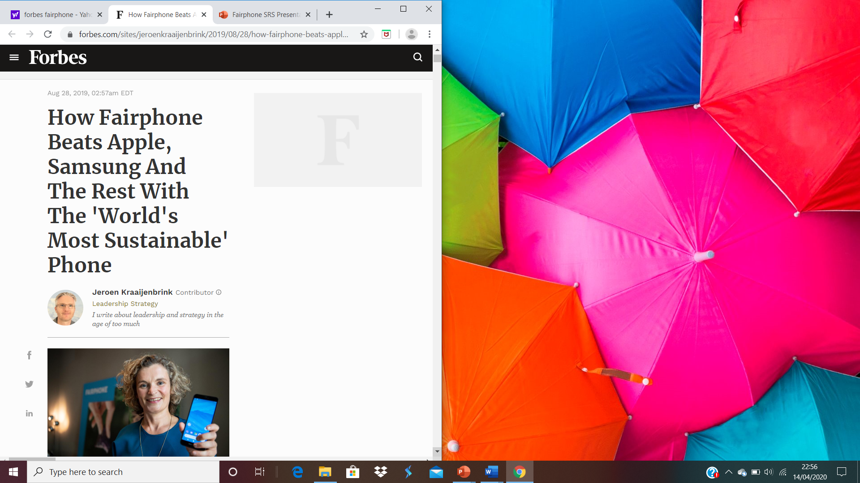
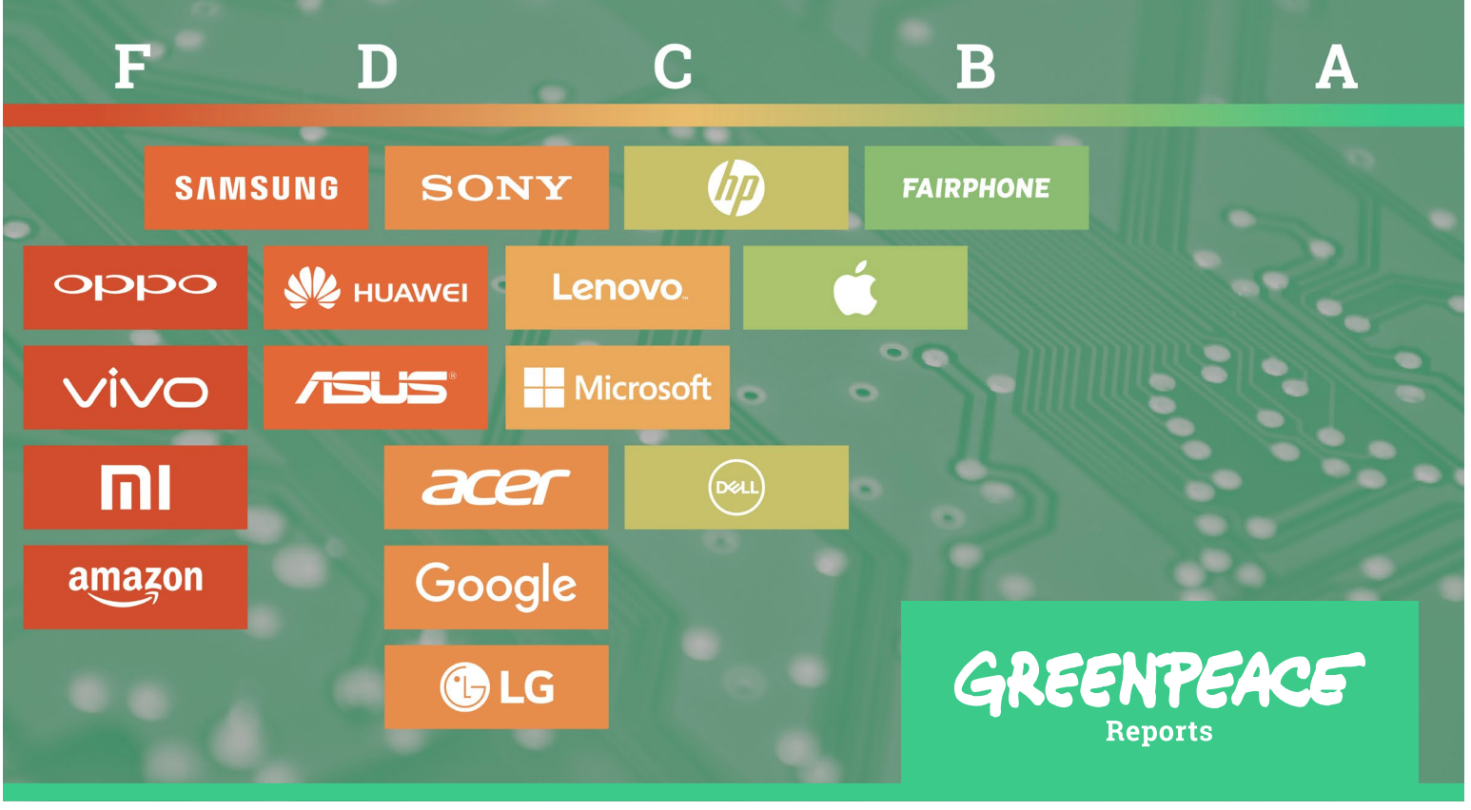
Notes:
Previous comparisons have placed fairphone as the most sustainable and ethical mobile on the market.

Slide 13
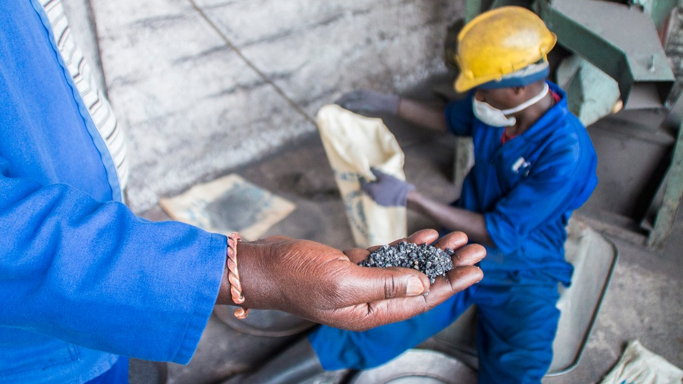
Notes:
Conflict free Fairphone Tungsten mine in Rwanda

Slide 14
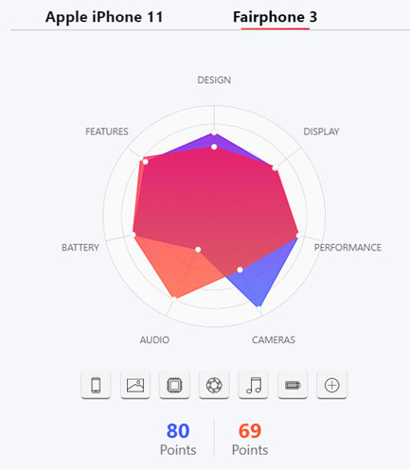

Fairphone vs apple
Fairphone Advantages
Better battery power
Lighter
Modular design - easier to recycle and therefore more environmentally friendly
£290 Cheaper than iPhone 11
Notes:
We can clearly see from this hexagonal graph that fairphone 3 is superior to IPhone 11 in terms of battery, CPU, resolution and weight, so it is more practical. Iphone 11 surpasses fairphone 3 in design and camera a lot, but Considering the actual situation of university applications, these functions are not as important as others.
At the same time, the huge difference in price makes fairphone affordable by more people. At the same time, as a kind of the most environmentally friendly mobile phone, its modular design makes maintenance and recycling more convenient. The service life of a mobile phone It can be as long as 5 years, so it is more environmentally friendly than Apple's one-year change.

Slide 15
Survey & Discussion

Slide 16
DATA COLLECTION
Survey
  48 participants
  Distributed via Information Services update
  Mix of multiple choice and open questions
    (Vogel, 2005)
Direct communications with Fairphone
Notes:
48 participants
Staff from across University (responses from over 20 departments)
Mix of multiple choice and open questions (12 in total)
Ref
Survey distributed via Information Services update email, to reach
Due to limited tme we have focused on four questions which offered the most interesting data and which informed our recommendations.
Direct communications with fairphone into feasibility of university adopting it as a smart phone and previous projects

Slide 17
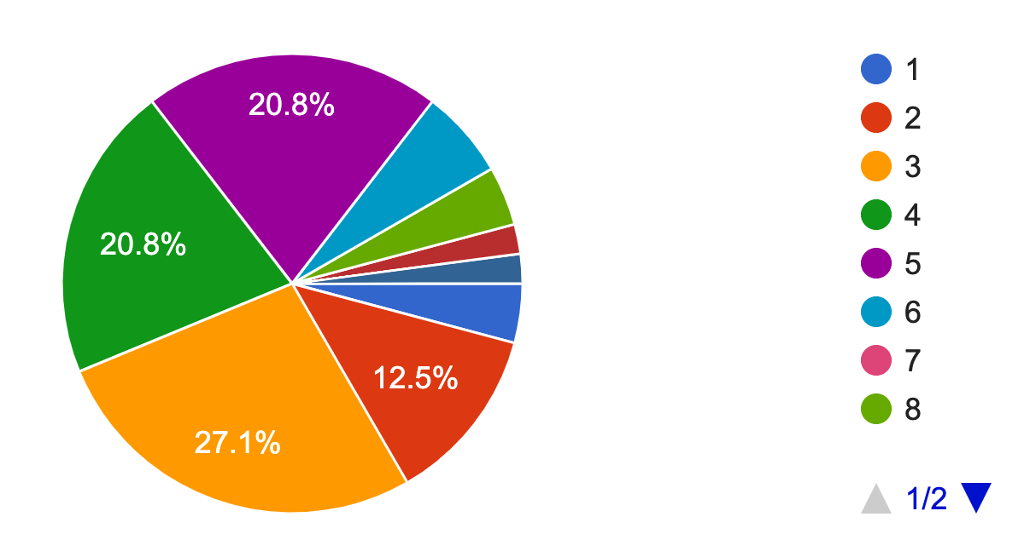
Handsets owned over previous 10 years
[One respondent had 10+]
Notes:
Just under 70% of those who responded had between 3-5 mob phones over the last 10 years. This high turnover is reflected in previous research as well, which has put this down to consumer fashion trends and programmed obsolescence (Paiano et al., 2013)

Slide 18
Barriers to using one phone
Separation of work and personal life
Privacy
Quality of phone
Notes:
We asked if you have both a work and personal mobile why is this the case? Top 3 reasons listed
83% of those issued with a work phone suggested separating work and home was a reason for owning two phones
Similarly the privacy of having your own number unrelated to work was a barrier
People tend to want high end phones and work phones don't necessarily offer that option, quality of phone cameras for instance was one of the main factors when choosing a new phone.

Slide 19
Would you be happy to receive a Fairphone as a work handset?
91.7%
Yes
8.3%
No
Notes:
Despite the barriers for staff owning just one handset for both work and personal affairs, over 90% of respondents said they would be happy to receive a Fairphone as their work handset
We believe that the dual sim aspect is a key reason for this, and gives a strong indication of its potential to become the university's work phone

Slide 20
How can we encourage use of the fairphone?
"Make it the only option. If the Uni is serious about sustainability, they won't give staff a choice on matters like this"
- Respondent 19
16 of 48 participants suggested some form of mandatory scheme, or provision as a first choice handset
11 of 48 mentioned greater education, awareness campaigns and promotion by the university
"Explain (the) alignment of Fairphone's principles with those of the University"
- Respondent 13
Notes:
Therefore it was pertinent for us to explore how to encourage more enthusiastic uptake of the Fairphone
What we as a group wanted to know was if the univeristy is serious about a work phone scheme involving the Fairphone, what could be done to help with the implementation of such a project, and what could ease the difficulty of this transition
The results from the survey provided two very popular suggestions of how to encourage uptake
A quarter of responses suggested either giving no option over the choice of handset, as seen from this quote by Respondent 19, or making the Fairphone 3 the standard, and force an opt-out scheme with valid reasoning provided
This implies that the respondents may acknowledge staff care about the issues Fairphone highlight, however it can be tempting to go for more popular models with higher specs if given the choice
Some of these responses said if the university was serious about its environmental commitments, the Fairphone should be listed as the only option
A large proportion of responses also mentioned the need for greater awareness and education
Many individuals may care greatly about issues Fairphone are attempting to address, but have no idea they exist or what their work entails
Active promotion and awareness campaigns carried out by the university could solve this, and encourage more enthusiastic participation in a Fairphone handset scheme

Slide 21
"show the benefits, raise awareness of ease of fixing/repairing, how about getting students to work with Fairphone on improving performance and making them more user-friendly?"
- Respondent 42
Notes:
One other respondent had a very interesting alternative suggestion for how to encourage Fairphone usage, which involved getting students to work on more fairphone projects
The involvement of students, especially those within Geosciences, could help foster a more holistic approach to facilitate a greater university-wide usage of Fairphone, especially amongst other students

Slide 22
Limitations of the survey
Only 24.5% of respondents have a work phone
Limited data pool
Notes:
Question price here? because Fairphone is relatively cheap? (no belongs in another slide)
Our survey had two limitations,
From the total survey, only 12 people had been issued a ‘work phone’. however, the rest of the questions were based ownership of
a mobile phone, so the37 responses were relevant elsewhere.
2) Also, due to various circumstances out of out control, our pool of respondants overall was small, with 49 responses.

Slide 23
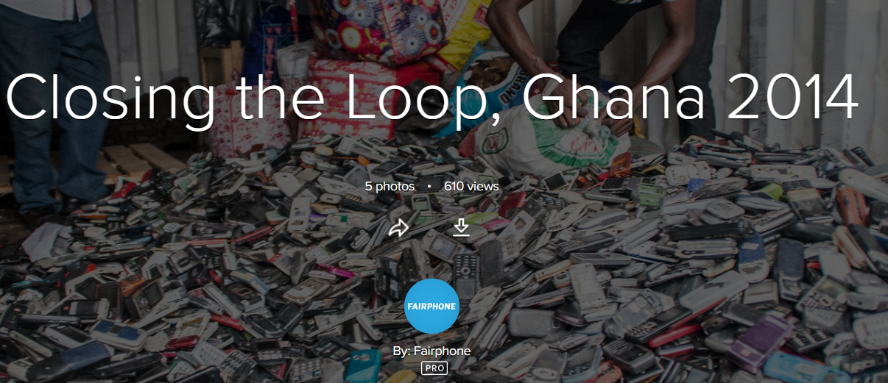
'Helping end our throw-away culture'
'our journey towards becoming a net-zero society'
Fairphone is the most sustainable phone on the market
SCOTTISH GOV: CIRCULAR ECONOMY BILL (IN PROCESS)
Notes:
Wider perspective fits into the wider circular economy goals. Fairphone's closing the loop scheme of returning waste to belgium to be recycled.
Gov.scot. (2019) Circular Economy Bill - Gov.Scot. [online] Available at: <https://www.gov.scot/news/circular-economy-bill/> [Accessed 13 April 2020].

Slide 24
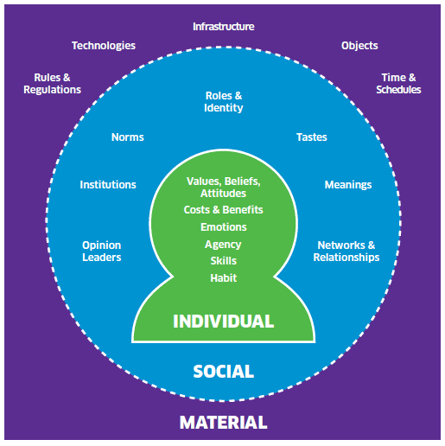
Recommendations
Informed by Fairphone feedback & data
An initial trial within one of the University departments of:
  M - An opt out scheme
  M - Department IT support holds spare parts
  M - Phone assigned to job role
  S & I - Simultaneous awareness campaign
Notes:
Existing schemes & feasibility checked with Fairphone
UoE previously enquired into Fairphone 2 but was just as the product came to the end of its product life
Parisian software company has equipped a 60 strong team and other businesses showing interest
1,000 units feasible, spare parts encouraged
Recommendations formulated using Scot gov ISM model which promotes long lasting behavioral change
An initial trial within one of the University departments of:
M - An opt out scheme for Fairphone 3
M - Department IT support holds spare parts to repair damaged phones
M - Phone assigned to job role to reduce number of work phones in circulation – perhaps an option to buy the Fairphone 3 at the end of tenure
S & I - Simultaneous awareness campaign that explains how the Fairphone 3 matches the University's/individual' s values, the duel sim feature that allows you to switch off work SIM and about the wider sustainability issues in the mobile industry.

Slide 25
Future Research
Clear willingness to embrace Fairphone among staff
Despite some sacrifice in performance – it is an ethical, sustainable and worthwhile choice
Potential for student uptake – incentivised scheme?
The impact of such a project would be significant
Notes:
From our research project, despite the sacrifices in some aspects of performance, it is evident staff are willing to embrace the Fairphone as their work handset, with the benefit of a dual sim system clearly being advantageous
Implementing a scheme with staff would clearly be beneficial for the university, ethically and environmentally, however the number of participants could be bigger
Many students themselves are likely to be keen to make more ethical consumer choices and protect the environment
A similar study into the opinions of students and the potential effectiveness of a strategy to encourage student uptake of the Fairphone would be the next recommended stage of research
A potential scheme could take the form of a small financial subsidy to new students when looking for a new handset themselves

Slide 26
"At the end of the day, real change in recycling and repairability will be driven by a joint effort from niche players like Fairphone, major industry players, policy makers and ultimately, the consumer"
- Reuter et al. (2018, pp. 78)
Notes:
This is for a very important reason, because as Reuter et al. has shown in this quotation, Fairphone is not alone in maneovuring mass change in the mobile phone industry. It will depend on how all actors behave, and us the consumers, are in a powerful position to help initiate this change.

Slide 27
Conclusions
Sustainability of the mobile phone industry
Fairphone 3 a partial solution
Majority of staff would have no issue with Fairphone 3 as a work phone
Initial trial within one of the University departments
Notes:
The mobile phone industry causes significant environmental damage and often is enabled by unethical procedures
Fairphone 3 does address some of those issues and is open about those it can not
Speaks for itself, over 90% of staff happy
Recommendations are feasible and run via fairphone

Slide 28
References
Butsic, V., Baumann, M., Shortland, A., Walker, S. and Kuemmerle, T. (2015) Conservation and conflict in the Democratic Republic of Congo: The impacts of warfare, mining, and protected areas on deforestation. Biological conservation, 191, pp. 266-273.
Fairphone (2020) The Phone That Cares For People And Planet. [online] Available at: https://www.fairphone.com/en/ (Accessed 2nd April 2020).
Forbes (2019) How Fairphone beats Apple, Samsung and the Rest. Available at: https://www.forbes.com/sites/jeroenkraaijenbrink/2019/08/28/how-fairphone-beats-apple-samsung-and-the-rest-with-the-worlds-most-sustainable-phone/ (Accessed 15th March 2020).
Greenpeace (2008) Poisoning the poor. Available on: https://www.greenpeace.org/archive-international/Global/international/planet-2/report/2008/9/poisoning-the-poor-electonic.pdf (Accessed 15th March 2020).
Greenpeace (2017) A guide to greener electronics. –http://www. greenpeace.org/usa/wp-content/uploads/2017/10/Guide-to-Greener-Electronics-2017.pdf Guardian. (2019), Fairphone review. Available at: https://www.theguardian.com/technology/2019/sep/18/fairphone-3-review-ethical-phone (Accessed 14th March 2020)
Guardian. (2017). 'Life and death in Apple's forbidden city. Available at: https://www.theguardian.com/technology/2017/jun/18/foxconn-life-death-forbidden-city-longhua-suicide-apple-iphone-brian-merchant-one-device-extract (Accessed 15th March 2020)
Paiano, A., Lagioia, G. and Cataldo, A. (2013) A critical analysis of the sustainability of mobile phone use. Resources, Conservation and Recycling, 73, pp. 162-171.

Slide 29
References
Reuter, M. A., van Schaik, A. and Ballester, M. (2018) ‘Limits of the circular economy: Fairphone modular design pushing the limits’, Metallurgy–ERZMETALL, 71(2).
Scottish Government. (2013) Influencing behaviours – moving beyond individual user guide – ISM tool. Available on: https://www.gov.scot/publications/influencing-behaviours-moving-beyond-individual-user-guide-ism-tool/ (Accessed 15th March 2020).
Sovacool, B. K. (2019) ‘The precarious political economy of cobalt: Balancing prosperity, poverty, and brutality in artisanal and industrial mining in the Democratic Republic of the Congo’, The Extractive Industries and Society, 6(3), pp. 915-939.
Statista (2020) Cell Phone Sales Worldwide 2007-2020, Statista. Available at: https://www.statista.com/statistics/263437/global-smartphone-sales-to-end-users-since-2007/ (Accessed 5th April 2020).
Van Eynde, S. and Bachus, K. (2016) ‘Non-state participation in sustainable materials management: the case of Fairphone’, KU Leuven, pp.
Van Eynde, S. and Bachus, K. (2016) ‘Non-state Actors in Sustainable Materials Management: The case of Fairphone’, Policy Research Centre on Sustainable Materials Management, pp. 1-13.
Vogel, D. (2005) ‘Introduction to Interview Analysis and Presentation’, POLITIS. Available at: http://www.politis-europe.uni-oldenburg.de/download/IntroductiondataanalysisinPOLITIS.pdf (Accessed 27th February 2020).

